Slide 1

Bootstrap Grid

Slide 2
Prerequisites
Good knowledge about web application
Good knowledge about HTML
Good knowledge about CSS
Basic understand about Bootstrap

Slide 3
Learning Objectives
Grid system
Container
Row
Columns
Spacing
Margin
Padding

Slide 4
Grid system
Bootstrap grid system provides an easy and powerful way to create responsive layouts of all shapes and sizes.
It is fully responsive and uses twelve column system (12 columns available per row) and six default responsive tiers.
Uses containers, rows, and columns to align content.

Slide 5
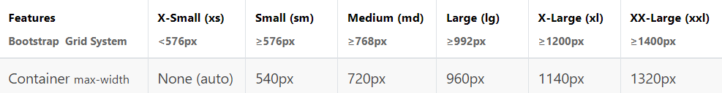
Bootstrap's grid system

Slide 6
Bootstrap Containers
Containers are the most basic layout element in Bootstrap and are required when using the grid system.
Containers are basically used to wrap content with some padding.
They are also used to align the content horizontally center on the page in case of fixed width layout.

Slide 7
Type of container
.container - which has a max-width at each responsive breakpoint.
.container-fluid - which has 100% width at all breakpoints.
.container-{breakpoint} - which has 100% width until the specified breakpoint.

Slide 8
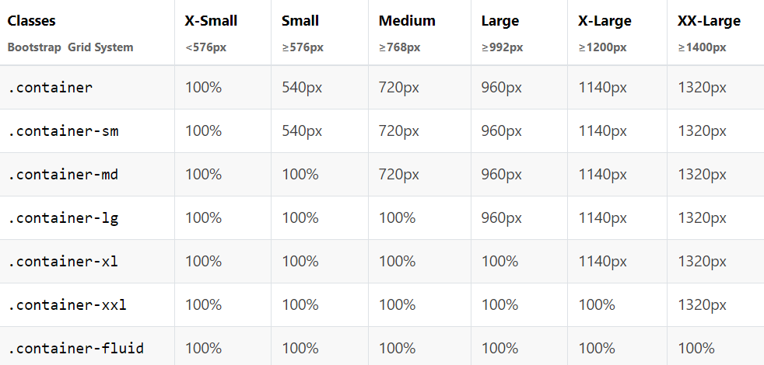

Slide 9
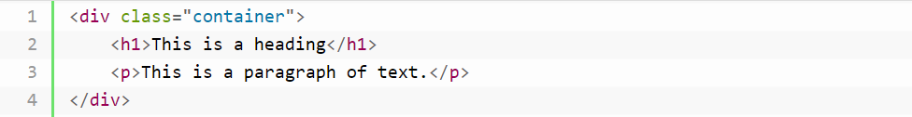
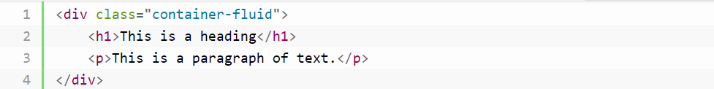
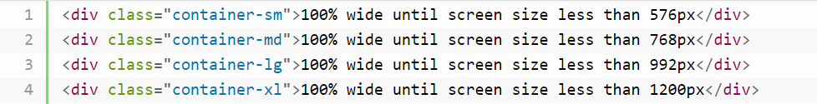

Slide 10
Row and Columns
Rows: Rows must be placed within a ‘container’ or ‘container-fluid’ for proper alignment and padding. We use rows to create horizontal groups of columns.
Columns: Grid columns are created by specifying the number of twelve available columns you wish to span.
Nesting Columns: For nesting columns within a column, we need to add a new row and set of columns. Nested rows should include a set of columns that add up to 12 or less than that.

Slide 11
Offsetting the Grid Columns
You can also move grid columns to the right for alignment purpose using the column offset classes like .offset-sm-*, .offset-md-*, .offset-lg-*, and so on.
These classes offset the columns by simply increasing its left margin by specified number of columns.

Slide 12
Bootstrap grid system rules
Rows must be placed within a .container (fixed-width) or .container-fluid (full-width) for proper alignment and padding
Use rows to create horizontal groups of columns
Content should be placed within columns, and only columns may be immediate children of rows
Grid columns are created by specifying the number of 12 available columns you wish to span. For example, three equal columns would use three .col-sm-4

Slide 13
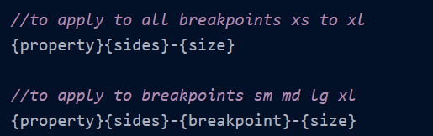
Spacing
Spacing in Bootstrap is implemented by using Bootstrap utility classes to set margin and padding.
Bootstrap spacing utilities are short-hand bootstrap classes that help apply response-friendly spaces in between elements in a webpage.
The bootstrap spacing utility classes are named using the following general syntax:

Slide 14
Syntax
Property: It can be either of m or p to specify margin or padding.
Sides: It is used to specify the side in which the margin or padding is to be modified. It takes the following values:
t - for classes that set margin-top/padding-top
b - for classes that set margin-bottom/padding-bottom
l - for classes that set margin-left/padding-left
r - for classes that set margin-right/padding-right
y - for classes that set both margin-top and margin-bottom or both padding-top and padding-bottom. In other words, it adds space on the y-axis.
x - for classes that set both margin-left and margin-right or both padding-left and padding-right. In other words, it adds space on the x-axis.
blank - for classes that set margin and padding to all four sides.

Slide 15
Breakpoint: Is any of the four breakpoints(excluding xs):
sm : viewport ≥576px
md : viewport ≥768px
lg : viewport ≥992px
xl : viewport ≥1200px

Slide 16
Size: It is used to specify the size of the margin or padding that is to be modified. It takes the following values:
0 - to set the margin or padding to 0
1 - (by default) sets the margin or padding to $spacer* .25 i.e. .25 rem or 4px
2 - (by default) sets the margin or padding to $spacer* .5 i.e. .5 rem or 8px
3 - (by default) sets the margin or padding to $spacer i.e. 1rem or 16px
4 - (by default) sets the margin or padding to $spacer* 1.5 i.e. 1.5 rem or 24px
5 - (by default) sets the margin or padding to $spacer* 3 i.e. 3rem or 48px
auto - for classes that set the margin to auto.

Slide 17


